Slide 1



Course: Data Mining
Bachelor Study Programme: Computer Science and Technology
Lesson 6:
Clusterization. K-Means
Ass. prof. E. Pinevich

Slide 2
Learning Objectives
After studying this lesson, you will know:
What is clustering for?
Definition of clustering
Clustering algorithms are divided into two groups
Disadvantages of clustering
K-Means algorithm
Cluster using graphs algorithm
After studying this lesson, you should be able to:
Cluster using graphs
Calculate the distances from the points to the centroids
Cluster using the K-Means algorithm

Slide 3
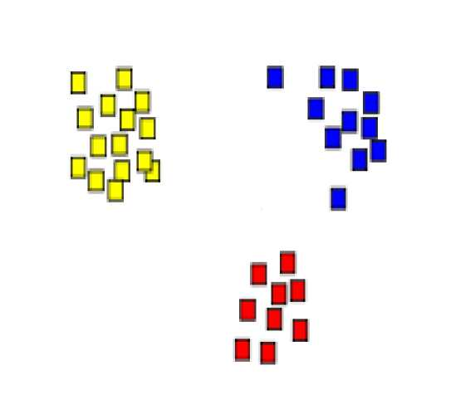
ISSUE 1: Definition of clustering
A set of objects is given.
Its need to be divided into several groups (clusters) consisting of objects similar to each other.
Notes:
For example, it is an architectural design issue whether a computer will have
a multiply instruction. It is an organizational issue whether that instruction will be
implemented by a special multiply unit or by a mechanism that makes repeated
use of the add unit of the system. The organizational decision may be based on the
anticipated frequency of use of the multiply instruction, the relative speed of the
two approaches, and the cost and physical size of a special multiply unit
Many computer manufacturers offer a family of computer models, all with the same architecture but with differences in organization.
In a class of computers called microcomputers, the relationship between
architecture and organization is very close. Changes in technology not only influence organization but also result in the introduction of more powerful and more
complex architectures. Generally, there is less of a requirement for generation to-generation compatibility for these smaller machines.

Slide 4
What is clustering for?
To calculate the degree of similarity of objects.
For example: the content of web pages are close to each other, which users of the social network are close to each other in interests ...
2. Simplify further data processing, divide the set into groups of similar objects in order to work with each group separately.
3. Reduce the amount of stored data, leaving one representative (standard) from each cluster (data compression tasks).
4. Search for outliers.
5. Divide the features into clusters and leave one feature from each cluster (feature selection).
Notes:
In general terms, there are only four basic functions that a computer can perform.

Slide 5
Clustering algorithms are divided into groups:
Algorithms that divide data into a given number of clusters (that is, the number of clusters is the input parameter of the algorithm).
Example: K-MEANS algorithm.
2. Algorithms in which the number of clusters is not determined in advance, but is calculated by the algorithm itself.
Example: FOREL algorithm.
Notes:
There are four main structural components
■ Control unit: Controls the operation of the CPU and hence the computer.
■ Arithmetic and logic unit (ALU): Performs the computer’s data processing functions.
■ Registers: Provides storage internal to the CPU.
■ CPU interconnection: Some mechanism that provides for communication among the control unit, ALU, and registers.
In recent years, there has been increasing use of multiple processors in a single computer. Some design issues relating to multiple processors crop up

Slide 6
Disadvantages of clustering of each type
1 (type).
A person may not guess the "right" number of clusters.
For example, for the objects in the picture, a person can start splitting into 2 or 4 or 1 clusters.
2 (type).
The algorithm may output too many (few) clusters. Such clustering is useless.
For example, the objects in the picture can be divided into 1 or 10 clusters (and this is bad).
Notes:
Computers generally have multiple processors.
When these processors all reside on a single chip, the term multicore computer is used, and each processing unit (consisting of a control unit, ALU, registers, and perhaps cache) is called a core. To clarify the terminology, this text will use the following definitions.
The main printed circuit board in a computer is called a system board or motherboard
The motherboard contains a slot or socket for the processor chip, which typically contains multiple individual cores, in what is known as a multicore processor.
A chip is a single piece of semiconducting material, typically silicon, upon which electronic circuits and logic gates are fabricated. The resulting product is referred to as an integrated circuit.
Another prominent feature of contemporary computers is the use of multiple layers of memory, called cache memory, between the processor and main memory.
Next, we zoom in on the structure of a single core, which occupies a portion of the processor chip. In general terms, the functional elements of a core are:
■ Instruction logic: This includes the tasks involved in fetching instructions, and decoding each instruction to determine the instruction operation and the memory locations of any operands.
■ Arithmetic and logic unit (ALU): Performs the operation specified by an instruction.
■ Load/store logic: Manages the transfer of data to and from main memory via cache.

Slide 7
Don't forget that
If the clustering algorithm uses a metric on a set of objects,
then the values of all features must first be normalized.
Notes:
The first generation of computers used vacuum tubes for digital logic elements and memory. A number of research and then commercial computers were built using vacuum tubes. For our purposes, it will be instructive to examine perhaps the most
famous first-generation computer, known as the IAS computer. This example illustrates many of the fundamental concepts found in all computer systems.
A fundamental design approach first implemented in the IAS computer is known as the stored-program concept. This idea is usually attributed to the mathematician John von Neumann.
Alan Turing developed the idea at about the same time.
The first publication of the idea was in a 1945 proposal by von Neumann for a new computer, the EDVAC (Electronic Discrete Variable Computer).
In 1946, von Neumann and his colleagues began the design of a new stored program computer, referred to as the IAS computer, at the Princeton Institute for
Advanced Studies. The IAS computer, although not completed until 1952, is the prototype of all subsequent general-purpose computers.
Since the device is primarily a computer, it will have to perform the elementary operations of arithmetic most frequently. These are addition, subtraction, multiplication, and division.
■ Memory buffer register (MBR): Contains a word to be stored in memory or sent
to the I/O unit, or is used to receive a word from memory or from the I/O unit.
■ Memory address register (MAR): Specifies the address in memory of the word
to be written from or read into the MBR.
■ Instruction register (IR): Contains the 8-bit opcode instruction being executed.
■ Instruction buffer register (IBR): Employed to hold temporarily the righthand instruction from a word in memory.
■ Program counter (PC): Contains the address of the next instruction pair to be fetched from memory.
■ Accumulator (AC) and multiplier quotient (MQ): Employed to hold temporarily operands and results of ALU operations. For example, the result of multiplying two 40-bit numbers is an 80-bit number

Slide 8
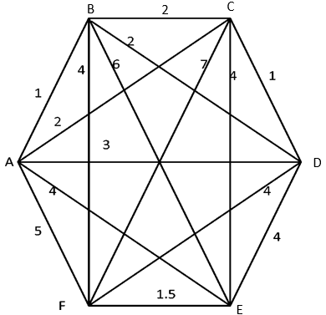
ISSUE 2: Clustering using graphs
Data presentation
It is necessary to calculate the distance between all pairs of objects and present this data as a graph.
Notes:
The integrated circuit exploits the fact that such components as transistors, resistors, and conductors can be fabricated from a semiconductor such as silicon. It is merely an extension of the solid-state art to fabricate an entire circuit in a tiny piece of silicon rather than assemble discrete components made from separate pieces of silicon into the same circuit. Many transistors can be produced at the same time on a single wafer of silicon. Equally important, these transistors can be connected with a process of metallization to form circuits.
A thin wafer of silicon is divided into a matrix of small areas, each a few millimeters square. The identical circuit pattern is fabricated in each area, and the wafer is broken up into chips. Each chip consists of many gates and/or memory cells plus a number of input and output attachment points

Slide 9
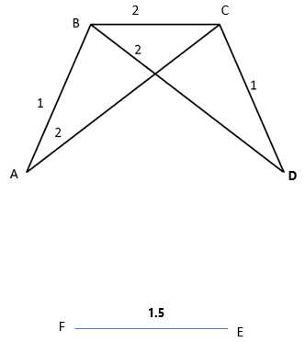
Description of the algorithm
The number R is supplied to the input of the algorithm.
We delete all edges in the graph, which labels are > R.
For example, for R=2 we get the following picture:
Clusters are connected components of the graph.
The first cluster is {A,B,C,D} and the second cluster is {E,F}.
Notes:
Moore observed that the number of transistors that could be
put on a single chip was doubling every year, and correctly predicted that this pace
would continue into the near future.
3. The computer becomes smaller, making it more convenient to place in a variety of environments.
4. There is a reduction in power requirements.
5. The interconnections on the integrated circuit are much more reliable than
solder connections. With more circuitry on each chip, there are fewer interchip connections.

Slide 10
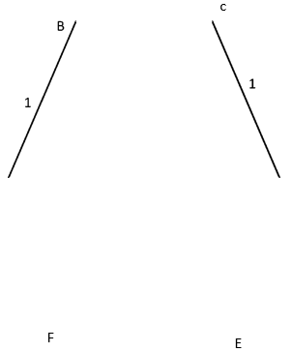
Description of the algorithm
If the number 1.4 is applied to the input of the algorithm, we will get 4 clusters.
{A,B}, {C,D}, {E}, {F}
A
D
As you can see, this algorithm does not allow splitting data into a fixed number of clusters.
Notes:
Pentium III: The Pentium III incorporates additional floating- point instructions: The Streaming SIMD Extensions (SSE) instruction set extension added 70 new instructions
Core: This is the first Intel x86 microprocessor with a dual core, referring to the implementation of two cores on a single chip
Core 2: The Core 2 extends the Core architecture to 64 bits.
Core i9 :
Core i9 is a family of high-performance and high core count 64-bit x86 microprocessors introduced by Intel in mid-2017

Slide 11
ISSUE 2: The K-MEANS algorithm
The main property of the algorithm: the number of clusters is determined in advance.
The idea of the implementation: all cluster centers are searched at the same time.
Notes:
A microcontroller chip makes a substantially different use of the logic space available. Microcontrollers are heavily utilized in automation processes.
Another typical feature of a microcontroller is that it does not provide for human interaction. The microcontroller is programmed for a specific task, embedded in its device, and executes as and when required.
A microcontroller is a single chip that contains the processor,
non-volatile memory for the program (ROM), volatile memory for input and output
(RAM), a clock, and an I/O control unit
The processor portion of the microcontroller has a much lower silicon area than other microprocessors and much higher energy efficiency.

Slide 12
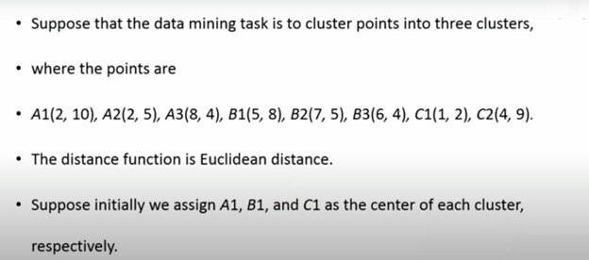
The K-MEANS algorithm
Notes:
ARM is a family of RISC-based microprocessors and microcontrollers designed by ARM Holdings, Cambridge, England.
CORTEX-A: These processors run at higher clock frequency (over 1 GHz), and support a memory management unit (MMU), which is required for full feature OSs such as Linux, Android, MS Windows, and mobile Oss
■ Cortex-M0: Designed for 8- and 16-bit applications, this model emphasizes low cost, ultra low power, and simplicity. It is optimized for small silicon die size (starting from 12k gates) and use in the lowest cost chips. ■ Cortex-M0+: An enhanced version of the M0 that is more energy efficient.
■ Cortex- M3: Designed for 16- and 32-bit applications, this model emphasizes performance and energy efficiency. It also has comprehensive debug and trace features to enable software developers to develop their applications quickly.
■ Cortex-M4: This model provides all the features of the Cortex-M3, with additional instructions to support digital signal processing tasks.
■ Cortex-M7: Provides higher performance than the M4. It is still primarily a 32-bit machine but uses 64-bit wide instruction and data buses.
■ Cortex-M23: This model is similar to the M0+, and adds integer divide instructions and some security features.
■ Cortex-M33: This model is similar to the M4, and adds some security features.

Slide 13
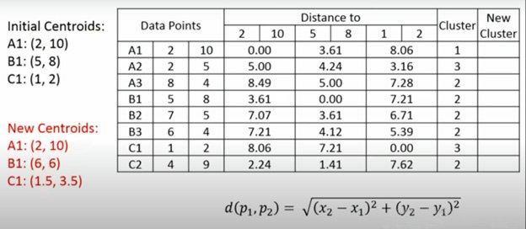
The K-MEANS algorithm
Let the centroids be A1, B1, C1.
Let's calculate the distances from the points to the centroids.
The smallest distance in the row is to determine the cluster number.
Since there are 5 points in the second cluster.
Let's calculate the arithmetic mean of the coordinates of these points. These will be the new centroids.
Notes:
■ NVIC: Provides configurable interrupt handling abilities to the processor. It
facilitates low- latency exception and interrupt handling, and controls power
management.
■ ETM: An optional debug component that enables reconstruction of program
execution. The ETM is designed to be a high- speed, low- power debug tool
that only supports instruction trace.
■ Debug access port (DAP): This provides an interface for external debug
access to the processor.
■ Debug logic: Basic debug functionality includes processor halt, single- step,
processor core register access, unlimited software breakpoints, and full system
memory access.
■ ICode interface: Fetches instructions from the code memory space.
■ SRAM & peripheral interface: Read/write interface to data memory and
peripheral devices.
■ Bus matrix: Connects the core and debug interfaces to external buses on the
microcontroller.
■ Memory protection unit: Protects critical data used by the operating system
from user applications, separating processing tasks by disallowing access
to each other’s data, disabling access to memory regions, allowing memory
regions to be defined as read-only, and detecting unexpected memory accesses
that could potentially break the system.

Slide 14
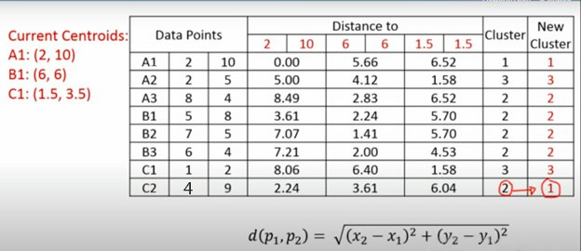
The K-MEANS algorithm
Let's calculate the distances to the new centroids.
The smallest distance in the rows determines whether it belongs to the new clusters.
Notes:
■ NVIC: Provides configurable interrupt handling abilities to the processor. It
facilitates low- latency exception and interrupt handling, and controls power
management.
■ ETM: An optional debug component that enables reconstruction of program
execution. The ETM is designed to be a high- speed, low- power debug tool
that only supports instruction trace.
■ Debug access port (DAP): This provides an interface for external debug
access to the processor.
■ Debug logic: Basic debug functionality includes processor halt, single- step,
processor core register access, unlimited software breakpoints, and full system
memory access.
■ ICode interface: Fetches instructions from the code memory space.
■ SRAM & peripheral interface: Read/write interface to data memory and
peripheral devices.
■ Bus matrix: Connects the core and debug interfaces to external buses on the
microcontroller.
■ Memory protection unit: Protects critical data used by the operating system
from user applications, separating processing tasks by disallowing access
to each other’s data, disabling access to memory regions, allowing memory
regions to be defined as read-only, and detecting unexpected memory accesses
that could potentially break the system.

Slide 15
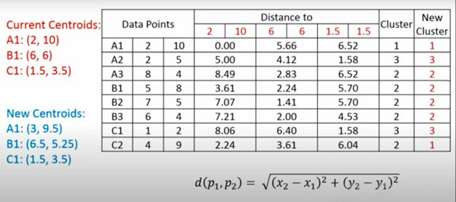
The K-MEANS algorithm
Since the values in the last two columns did not match, we calculate the arithmetic mean of the coordinates inside the clusters and get new centroids.
Notes:
■ NVIC: Provides configurable interrupt handling abilities to the processor. It
facilitates low- latency exception and interrupt handling, and controls power
management.
■ ETM: An optional debug component that enables reconstruction of program
execution. The ETM is designed to be a high- speed, low- power debug tool
that only supports instruction trace.
■ Debug access port (DAP): This provides an interface for external debug
access to the processor.
■ Debug logic: Basic debug functionality includes processor halt, single- step,
processor core register access, unlimited software breakpoints, and full system
memory access.
■ ICode interface: Fetches instructions from the code memory space.
■ SRAM & peripheral interface: Read/write interface to data memory and
peripheral devices.
■ Bus matrix: Connects the core and debug interfaces to external buses on the
microcontroller.
■ Memory protection unit: Protects critical data used by the operating system
from user applications, separating processing tasks by disallowing access
to each other’s data, disabling access to memory regions, allowing memory
regions to be defined as read-only, and detecting unexpected memory accesses
that could potentially break the system.

Slide 16
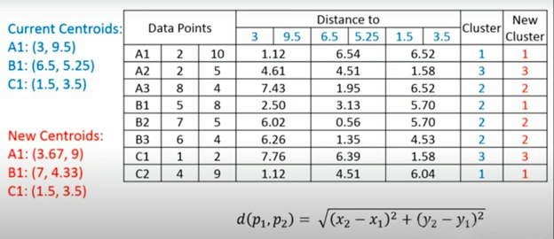
The K-MEANS algorithm
Since point B1 has changed the cluster number.
Let's calculate the arithmetic mean of the coordinates inside the clusters.
Notes:
■ NVIC: Provides configurable interrupt handling abilities to the processor. It
facilitates low- latency exception and interrupt handling, and controls power
management.
■ ETM: An optional debug component that enables reconstruction of program
execution. The ETM is designed to be a high- speed, low- power debug tool
that only supports instruction trace.
■ Debug access port (DAP): This provides an interface for external debug
access to the processor.
■ Debug logic: Basic debug functionality includes processor halt, single- step,
processor core register access, unlimited software breakpoints, and full system
memory access.
■ ICode interface: Fetches instructions from the code memory space.
■ SRAM & peripheral interface: Read/write interface to data memory and
peripheral devices.
■ Bus matrix: Connects the core and debug interfaces to external buses on the
microcontroller.
■ Memory protection unit: Protects critical data used by the operating system
from user applications, separating processing tasks by disallowing access
to each other’s data, disabling access to memory regions, allowing memory
regions to be defined as read-only, and detecting unexpected memory accesses
that could potentially break the system.

Slide 17
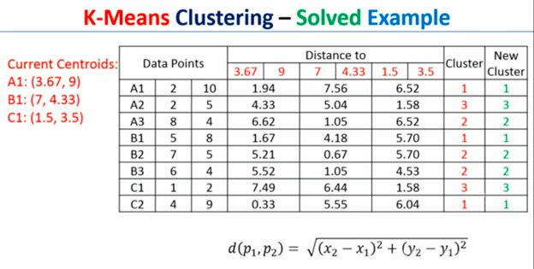
The K-MEANS algorithm
When the process is established: the values in the old clusters will match the values in the new clusters, the problem is solved.
Notes:
■ NVIC: Provides configurable interrupt handling abilities to the processor. It
facilitates low- latency exception and interrupt handling, and controls power
management.
■ ETM: An optional debug component that enables reconstruction of program
execution. The ETM is designed to be a high- speed, low- power debug tool
that only supports instruction trace.
■ Debug access port (DAP): This provides an interface for external debug
access to the processor.
■ Debug logic: Basic debug functionality includes processor halt, single- step,
processor core register access, unlimited software breakpoints, and full system
memory access.
■ ICode interface: Fetches instructions from the code memory space.
■ SRAM & peripheral interface: Read/write interface to data memory and
peripheral devices.
■ Bus matrix: Connects the core and debug interfaces to external buses on the
microcontroller.
■ Memory protection unit: Protects critical data used by the operating system
from user applications, separating processing tasks by disallowing access
to each other’s data, disabling access to memory regions, allowing memory
regions to be defined as read-only, and detecting unexpected memory accesses
that could potentially break the system.

Slide 18
Key Terms
algorithm mean distance feature object solve value | k-means centroid cluster point search edge group | components of the graph data presentation cluster points present data delete edge
Notes:
Today we have studied the following concepts
In the next lecture, we will repeat these concepts. You should explain their meaning in a few words. Everyone understands this ?
Until the next lecture

